Slide 1
NASA Request Log Analysis
By: Team 404 Not Found

Slide 2
Introduction
Task
Code Output

Slide 3
Task
Given – Two Datasets
NASA Logs of IP Address Requests
Execution
Determine top 10 longest response times
Determine top 10 URL searched
Predict the continent the IP addresses is from
Mapped the IP addresses

Slide 4
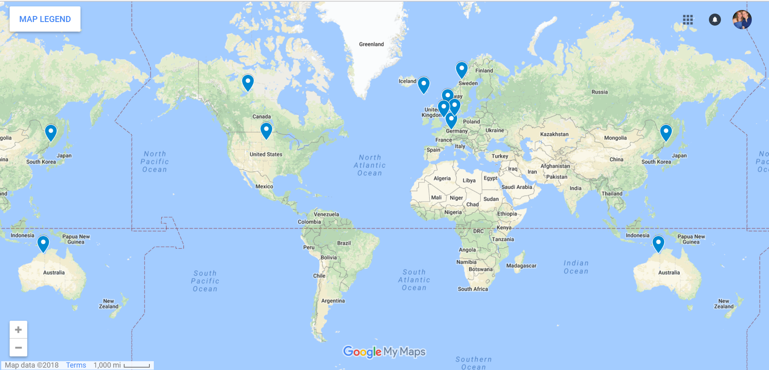
Code Output: Top 5 Countries will longest Response Time

Slide 5
Code Output: Predictions
Top 10 URLs Visited
/images/NASA-logosmall.gif
/images/KSC-logosmall.gif
/shuttle/countdown/count.gif
/shuttle/countdown/
/shuttle/missions/sts-71/sts-71-patch-small.gif
/images/MOSAIC-logosmall.gif
/images/USA-logosmall.gif
/images/ksclogo-medium.gif
/images/WORLD-logosmall.gif
/shuttle/missions/sts-71/images/images.html

Slide 6
Code Output: Predictions
Prediction
Logistic Regression
Accuracy 99.5%

Slide 7
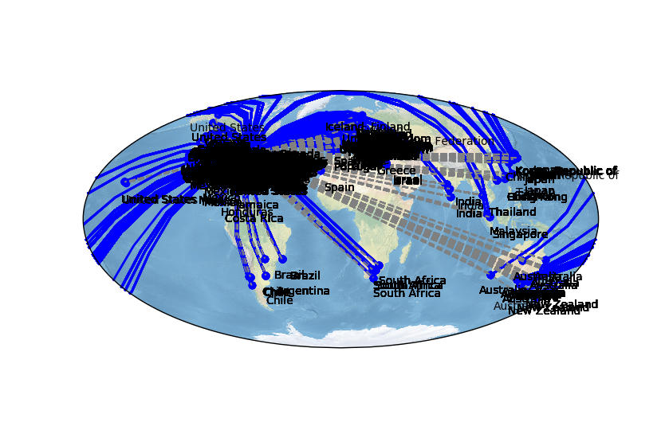
Code Output: Mapping IP Addresses

